Slide 1
Product Catalog Intergration
Project: eOneRate

Slide 2
High-Level Functionality of Product Catalog
Product Catalog được tổ chức bởi các logical layers tương ứng các lĩnh vực hoạt động và các nhóm người dùng khác nhau:
Basic System Infrastructure Layer: Cấu hình các dữ liệu hệ thống cơ bản như Các đơn vị - Units và Loại tiền tệ -Currencies
Service Layer: Định nghĩa các Usage activities và service-related details giống như notifications và access numbers
Rating and Billing Definition Layer: Thiết lập thông số rates, balances, accumulators và promotions
Marketing/Packaging Layer: Cấu hình customer-facing market offers

Slide 3
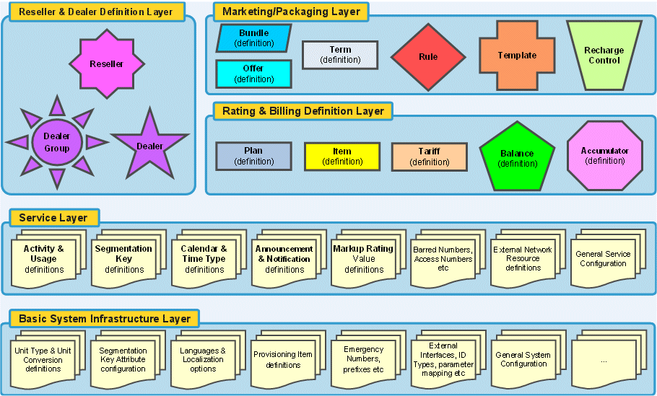
High-Level Functionality of Product Catalog

Slide 4
Offer
Offers được soạn từ plans, terms, balances, accumulators, templates, và rules là các thành phần được định nghĩa ở các layer thấp hơn..
Offer trong PCAT được xây dựng dựa trên các đối tượng có khả năng sử dụng lại từ mô hình của nó: activity type, usage, service, price, eligibility (Đủ điều kiện)
Dependencies with other offers, subscription conditions, service payments, and consumed credits

Slide 5
Offer
Types
Primary Offer: A subscriber cannot be provisioned without a primary offer.
Account Offer: An optional service offer associated to an account.
Supplementary Offer: Manages additional service capabilities to subscribers.

Slide 6
Activity Usage Types (AUTs)
An Activity Usage Type (AUT) specifies, for each record, the key that identifies a usage event type (for example, long distance phone calls, direct dial phone calls, network logins, and file downloads).
AUTs define and rate usage activity. An initial AUT defines a particular usage type and identifies which segmentation keys to use to guide and rate it. When a usage record enters the system, the rating engine checks the segmentation keys specified by the initial AUT. It looks up values for the segmentation keys and assigns those values to the record.
The record is then mapped to a ratable AUT, a final AUT, in a process called AUT translation. The translated record is ready to be rated and assigned to the correct balance.
Notes:
Usage Event Types: Các sự kiện sử dụng dịch vụ của người dùng bao gồm: Cuộc gọi đường dài, download file, gửi SMS, …
Khi một record được insert vào hệ thống:
Rating engine kiểm tra và thuộc Segmentation key nào để gán Values cho record này
Bản ghi này đượp map với bảng AUT và lựa chọn ra một final AUT
Rating engine xác định được Balance cần rate

Slide 7
Balance
A balance is a container or bucket for monetary or non-monetary funds that pay for usage or services.
Balance instances can be either prepaid or postpaid. (The prepaid or postpaid attribute is defined in the Offer/Balance Relationship window when you associate the balance to an offer.) They can be either monetary or unit-based (non-monetary). Prepaid balances can hold funds or units; postpaid balances can hold limits or units. Postpaid monetary balances are cyclical and must have spending or credit limits. Postpaid non-monetary balances are non-cyclical and cannot have spending or credit limits.

Slide 8
Determining Balance Order and Balance Amounts
The priority order of subscriber balances is based on the guided-to offer, the offer balance priority configured in the subscriber's Upsell Template, and the Balance Charge Order in the offers
When using an account balance as the target of a Shadow Balance, the balance properties are based on the highest priority instantiation of that balance to the account. The balance attributes (Min Value, Max Value, Inclusion / Exclusion, and so on) from the highest priority instantiation of the balance are used.

Slide 9
Balance Inclusion/Exclusion
Balance Exclusion/Inclusion checks two associations, AUT and Timetype. The design meets description such as, “This balance is eligible for all voice during peak."
Total Monetary Liability (TML)
Total Monetary Liability (TML) is an Account-level control used to limit total currency usage in postpaid Balances. It is not a balance, in that it does not really contain any funds. It is just a running limit of all postpaid currency charges in the Account and at the subscribers directly associated with the account. The functionality that TMLs supply is to provide another limit for postpaid currency usage.
Credit Limits
A credit limit is a value the operator sets on a balance in order to limit the amount of exposure or risk for the subscriber/account.
In general, credit limits are the values to which balances are reset on a periodic basis. So, for example, an operator who wishes to limit a subscriber's monthly use of a balance can set a credit limit on that balance, as well as a cycle period and a reset date. At the reset date, the balance value is reset to the credit limit value.

Slide 10
Accumulators
Accumulators are used to count or measure chargeable activities such as duration of voice calls, number of SMS sent or received, quantity of data usage, number and quantity of recharges, and so forth. Each Accumulator is configured to:
reset to 0 periodically (for example, daily, weekly, bill cycle, at the end of the call …)
count a specific type of unit:
event occurrence (for example, every SMS)
currency consumed or units consumed (seconds, K bytes, and so forth)
recharges (number of recharges or value of recharges)
include or exclude specific activities from being counted via Time Types (peak, off-peak, and so forth) and Activity Usage Types (local call, national call, international call, and so forth)

Slide 11
Accumulators and Promotions
Rating time and billing time promotions are also a key aspect of the offer definition.
Promotion plans define how bonuses or discounts apply to a subscriber who has subscribed the offer, based on accumulators and impacting balances.

Slide 12
Rules
Một vài loại rule điều hướng cách mà các offer được đăng ký. Chỉ một trong mỗi loại rule được liên kết tới một offer.
The account/subscriber prerequisite rule là một biểu thức dựa trên các thuộc tính của account hoặc subscriber
The bundle/offer prerequisite rule defines a list of bundles or offers that must be already subscribed in order to be able to get the concerned offer
The exclusion rule defines bundles or offers that are defined as incompatible with the concerned offer
The transition rule is a collection of primary offers that could act as possible targets when swapping primary offer. This rule only applies to primary offers.

Slide 13
Bundles
A bundle is a collection of offers or bundles that are provisioned to (cung cấp tới), or consumed by (tiêu thụ bởi), a subscription or an account. Bundles have several advantages:
Give operators flexibility in defining offers and pricing options.
Enable the bundling of offers together for marketing and commercial purposes.
Are sellable entities.
Enable the packaging of offers as a consistent commercial set

Slide 14
Bundles
Bundle Types :
Account Bundle: includes account offers and subscriber bundles. Assigning an account bundle to an account affects the instantiation of some subscribers attached to the account, based on subscriber bundles included in the account bundle.
Subscriber Bundle: A subscriber bundle includes a unique and mandatory primary offer and some supplementary offers.

Slide 15
Rating Segmentation Keys
Rating segmentation keys are used to configure the rating capability dependent upon some specific context and the key definitions. They include: account, location, market, subscriber, access method, offline and online rating.
Access Method Segmentation Key: Consists of existing system parameter: Calling Card.
Location Segmentation Key: A compound expression consisting of a Location Relationship (Point Class Origin, Point Class Target), Distance Band ID, Zone Class
Account Segmentation Key: Consists of compound expression defined via a combination of one or more account parameters that have been marked as applicable for the account rating segmentation key: Account Category, Regulatory ID, VIP Code
Subscriber Segmentation Key: Consists of compound expression defined via a combination of one or more subscriber/service parameters that has been marked as applicable for subscriber rating segmentation key: Class of Service, Subscriber Class, Subscriber Type.
Market Segmentation Key: Consists of a compound expression defined via a combination of one or more market parameters: Market Code, Provider Class.
Special Feature Segmentation Key: Consists of an existing system parameter for friends and family and calling circles and so forth.
Offline Segmentation Key: Offline segmentation keys consist of compound expressions defined via a combination of one or more offline rating parameters defined in the Product Catalog; for example, Bill Class.

Slide 16
Calendars and Rate and Time Periods
Tariff áp dụng tới các cuộc gọi phụ thuộc vào date and time của ngày xảy ra cuộc gọi. Các nhà mạng sử dụng các cách tính cước khác nhau cho những thời điểm khác nhau của ngày và các ngày trong tuần (weekdays/weekends). It is crucial to associate time types for the entire day without gaps (trống) or overlaps. Calendars enable operators to manage days of the year for regular or special rating and charging on a per-primary-offer basis.
Each primary offer has exactly one "default" calendar and zero to four "alternate" calendars. If appropriate, several primary offers share the same calendar, or each primary offer has its own dedicated calendar.

Slide 17
Calendars
To allow charging for time-sensitive transactions, a calendar with daily schedules and associated time types is provisioned for each tariff plan.
The calendar uses daily schedules to identify day type (weekday, weekend, or holiday). Multiple calendars accommodate special holidays or different off days versus workdays. They often share the same daily schedules or have their own daily schedules. If appropriate, several primary offers share the same calendar (so that multiple identical definitions are avoided).
Calendars and rate and time periods are used in the configuration of rating through usage and service plans.
When a subscriber makes a call, a tariff plan is pointed to as previously described. The associated calendar is consulted. Within that calendar, the daily schedule for the date the call is placed is the schedule that determines the time type.

Slide 18
Typical Calendar Scenario
define 3 time types — peak, off-peak, weekend
define weekend day type — single timeslot covering 24 hours, associated with weekend time type
define weekday day type:
first timeslot from midnight to 9 A.M., associated with off-peak
second timeslot from 9 A.M. to 6 P.M., associated with peak time type
third timeslot from 6 A.M. to midnight, associated with off-peak
associate weekend day type to Saturday and Sunday
associate weekday day type to Monday through Friday
create calendar exceptions for national holidays, associated to weekend day types (that is, weekend rates apply on national holidays)

Slide 19
Calendars and Day Types
The calendar uses daily schedules to identify day type (weekday, weekend, or holiday). There are multiple calendars to accommodate special holidays or different off days versus workdays. These calendars often share the same Daily Schedules or have their own daily schedules. If appropriate, several Classes of Service share the same calendar (so that multiple identical definitions are avoided).
When a call is made by a given subscriber, a tariff plan is pointed to as previously described. The associated calendar is consulted. Within that calendar, the daily schedule for the date the call is placed is the schedule that is used to determine the time type.

Slide 20
Time Types
In determining the tariff, time type information is critical for applications such as the voice call. Most wireless service providers use time type-based tariffs to promote or discourage subscribers from using the services at different times of the day. Time types are used as a rating key and are associated with each day period. Once all the data is in place (this includes defining the tariff plans for the primary offer, selecting a calendar for each tariff plan, and pointing that calendar to the appropriate daily schedules) the time type is obtained.
The system enables the operator to define various time types and selection of tariff based on the time type, called rate type. Time type defines the various times of the day as peak, off-peak, and others. For some applications like data or SMS, the Time Type is not relevant; however, it is crucial information for activities like the voice call.

Slide 21
Daily Schedules and Time Types
The daily schedule uses time types to define a 24-hour period. There are several daily schedules depending upon the workday, off day, special day (for example, Mother’s Day), and for various applications. For example, for voice calls, the peak hours are 8:00 AM – 5:00 PM but for data, the peak hours are from 7:00 PM until 11:00 PM because most backups are done during these hours. To accommodate these types of differences, the operator chooses to create different daily schedules for different activities.

Slide 22
Tariffs and Tariff Plans
Transactions that generate usage (voice calls, data transactions, and other information services on the system interfaces) are charged using tariffs. A tariff is a usage rate. It defines how much a transaction costs in terms of money per time unit (seconds) in the case of voice calls, or bytes when a data download is involved. For example, a call lasting 120 seconds based on a one cent per second tariff is charged at $1.20.
A tariff defines the following value for charging purposes: Charge unit size for the initial and additional consumption amounts. Charge unit size is the minimum amount that can be charged. For example, if charge unit size is 10 seconds and a subscriber consumes 55 seconds, they are charged for 60 seconds.
A complex set of algorithms and data structures for rating and charging subscriber transactions in real-time is employed. This model utilizes a multi-dimensional rating engine allowing for comprehensive rating schemes based on time, location, subscriber usage, features, and other criteria.

Slide 23
Tariff Plans
A tariff plan is a set of predefined tariffs (usage rates) used by the system to charge subscribers for transaction activities. Each tariff plan is assigned a calendar, allowing different tariffs to be configured by time type, and is assigned a unit type for charging purposes. A final AUT is associated with a tariff plan as part of a usage item. A usage item defines the available and permitted usage activities and their associated tariffs and thus is the relationship between Activity Usage Type (AUT) and tariff plan. Customized unit-based tariffs are specifically tailored to rate application activities.
Calendars, that contain multiple Time Types (intervals covering a 24 hour day are assigned to a tariff plan for further breakdown of time-sensitive charging to identify the tariffs applicable at the time of an activity. For example, the charge for a long distance call is dependent not only on the location relationship but also on the predefined calendar and time of day. Digital data services can be charged based on a time type as determined by the service provider.
Within each tariff plan, up to five concurrent tariffs can be assigned to each time type.

Slide 24
Tariff Plan Overrides
A tariff plan override defines a way to override a tariff plan upon specific conditions that apply to
the subscriber and its subscription. For example, tariff plan enables the implementation of special
rates for the subscriber's birthday (on the subscriber's birthday, use a different tariff plan).
The basic flow for guiding to a tariff plan is as follows: For the final AUT, or each final AUT if
there were splits:
Use the offer associated with the final AUT and find the tariff plan associated with final AUT.
Find the subscriber's tariff plan override template.

Slide 25
Tariff Plan -> Voice Calls
The charge for a telephone call generally depends on whether the call is local or international, whether the call is made during peak hours, and how long the call lasts. The system determines
these parameters by looking at the signaling information for the call. For a typical voice telephone call, the tariff depends on many factors including:
Time Type variable (date and time of day of the call)
Duration of the call
Dialed number
Subscriber home location (if defined)
Location relationship (location of the calling and called party)
OPPS (originating) or TPPS (terminating) call
Special feature associated with the call (such as Friends and Family)

Slide 26
Tariffs for Voice Calls
The tariff is more than just a single rate of X currency units per Y seconds. A tariff for any transaction is defined with the following basic parameters:
The unit type (for example, seconds for voice calls) for charging.
The currency of the tariff (for example, dollars, Euros). The system uses tariffs defined in multiple currency types.
The length of the initial consumption unit in seconds. This length must be at least one second.
The charge for the initial consumption unit (called the initial consumption charge), in minor
currency units, such as cents, the smallest subdivision of the dollar currency unit. A minor currency unit is typically 1/100th of any global major currency unit.
The length of any additional consumption units, in seconds. This length must be at least one second.
The charge for any additional consumption units (called the additional consumption charge) in minor currency units.
A tariff modifier or dependency (for example, a promotion type such as the Friends and Family feature) that indicates how the tariff is used in conjunction with another feature.

Slide 27
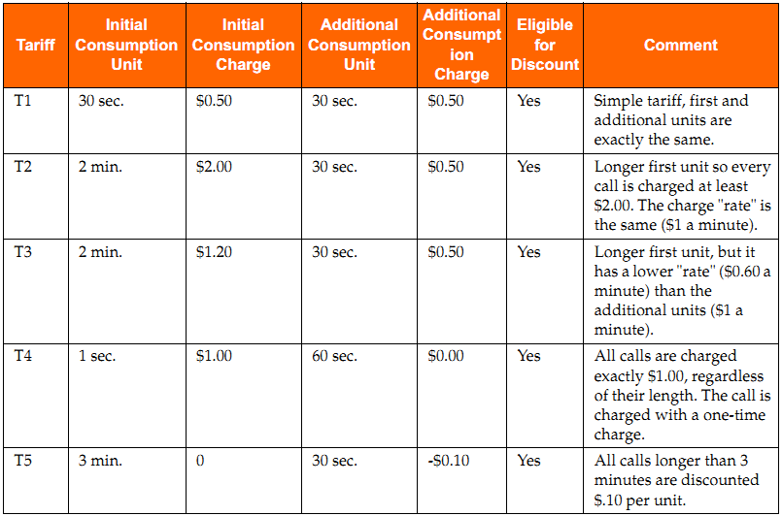
Tariff Example

Slide 28
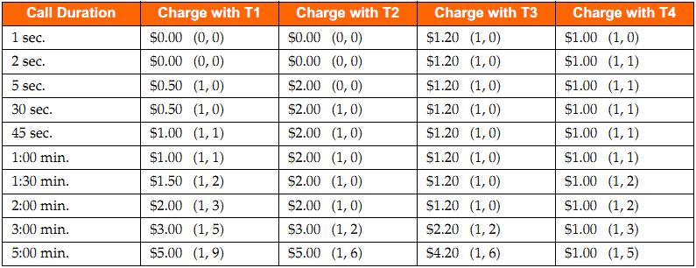
Results of Tariff Examples

Slide 29
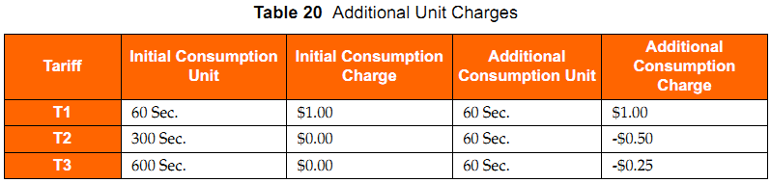
Negative Tariffs
Negative tariffs are used to support telescoping charges or to decrease per time unit charges for
calls over a period of time thus enabling the reduction of call charges when concurrent tariffs are used.

Slide 30
Settlement Tariff
A settlement tariff calculates a price but this amount is not charged to the subscribers balances. A settlement tariff calculates a price, but this amount is not charged to the subscriber’s balances. Its primary use is to track the cost of the call to the network operator. For example, a subscriber makes a call from Germany to France. A tariff called settlement tracks values that determine how much the French network charges the German network operator for the French network usage. This information is recorded only in a CDR, and is used to reconcile charges between or within network operators.

Slide 31
Markup Rating
Markup rating enables the subscriber’s home operator to add a percentage markup to a roaming charge. The home system makes money on the usage associated with roaming subscriber originating voice calls from non-CAMEL 2 foreign networks.
Markup Correlation
Markup correlation provisions a markup to a GSM provider and assigns a charge code and a service code to the markup.
Users can view, modify, and enable or disable currently configured markup correlations for the primary offer. The markup rating definition must be first completed before performing these procedures.

Slide 32
Recharge Control
The Recharge Control Table (RCT) modifies the behavior of a recharge. The Recharge Control
Table can:
Enable a recharge (which contains a single value and a single expiration offset) to affect multiple balances and their associated grants
Modify the balance amounts and expiration adjustments specified in the recharge. For example, to change a $5.00, 10-day recharge into a $7.00, 30-day recharge.
Swap the primary offer of the subscriber being recharged
Add supplemental offers to the subscriber or account being recharged.

Slide 33
Pseudo Locations
Pseudo locations can be defined for non-location-related call destinations. The following are examples of typical uses of pseudo locations:
Toll-Free numbers.
International calls (the location of the caller within the country is not important; the country prefix is determines the tariff).
Special services (premium rate, directory assistance, and so forth.).
Calls to other cellular networks within the same country (each network does not have access to the other network’s Home Location Register (HLR)).

Slide 34
Digital Data Transactions
Digital data transactions and information services are typically rated by the content and volume of the transaction. An example is the number of megabytes transferred in the case of a file downloaded from the Internet, and perhaps whether the content was a premium audio or video data transfer.
For data and information services, certain factors used to charge for a telephone call are often not relevant, such as the location of the originating and destination parties. Determining the tariff for
data services involves factors such as:
Time-Type variable: The date and the time of day of the transaction
Duration: Seconds
Volume: Number of octets (bytes) transferred
Content: Type, premium level of the service
Quality of Service: Characteristics of the data session (56 Kbps, DSL, cable)

Slide 35
Rating-Time Promotions (Discounts)
The overall concept can be summarized as follows:
While rating, appropriate usage is counted via accumulators.
Discounts and bonuses are linked to thresholds of one or more accumulators.
When the threshold conditions are met, the discount or bonus is applied.
Rating Time Discounts only apply to monetary units. Examples:
After 100 minutes of voice use, calls are discounted by 5%.
For every 100 SMS, the next 50 are discounted by 50%.
After 100 voice calls every future MMS will be discounted by $0.10.

